Slide 1
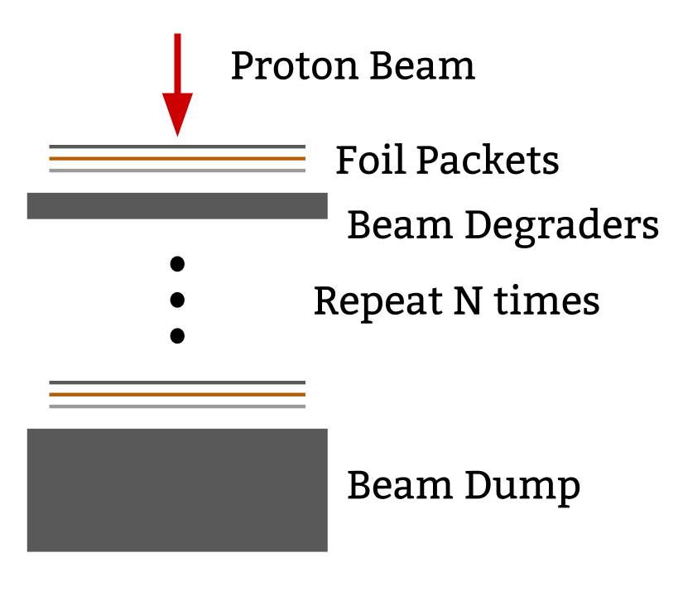
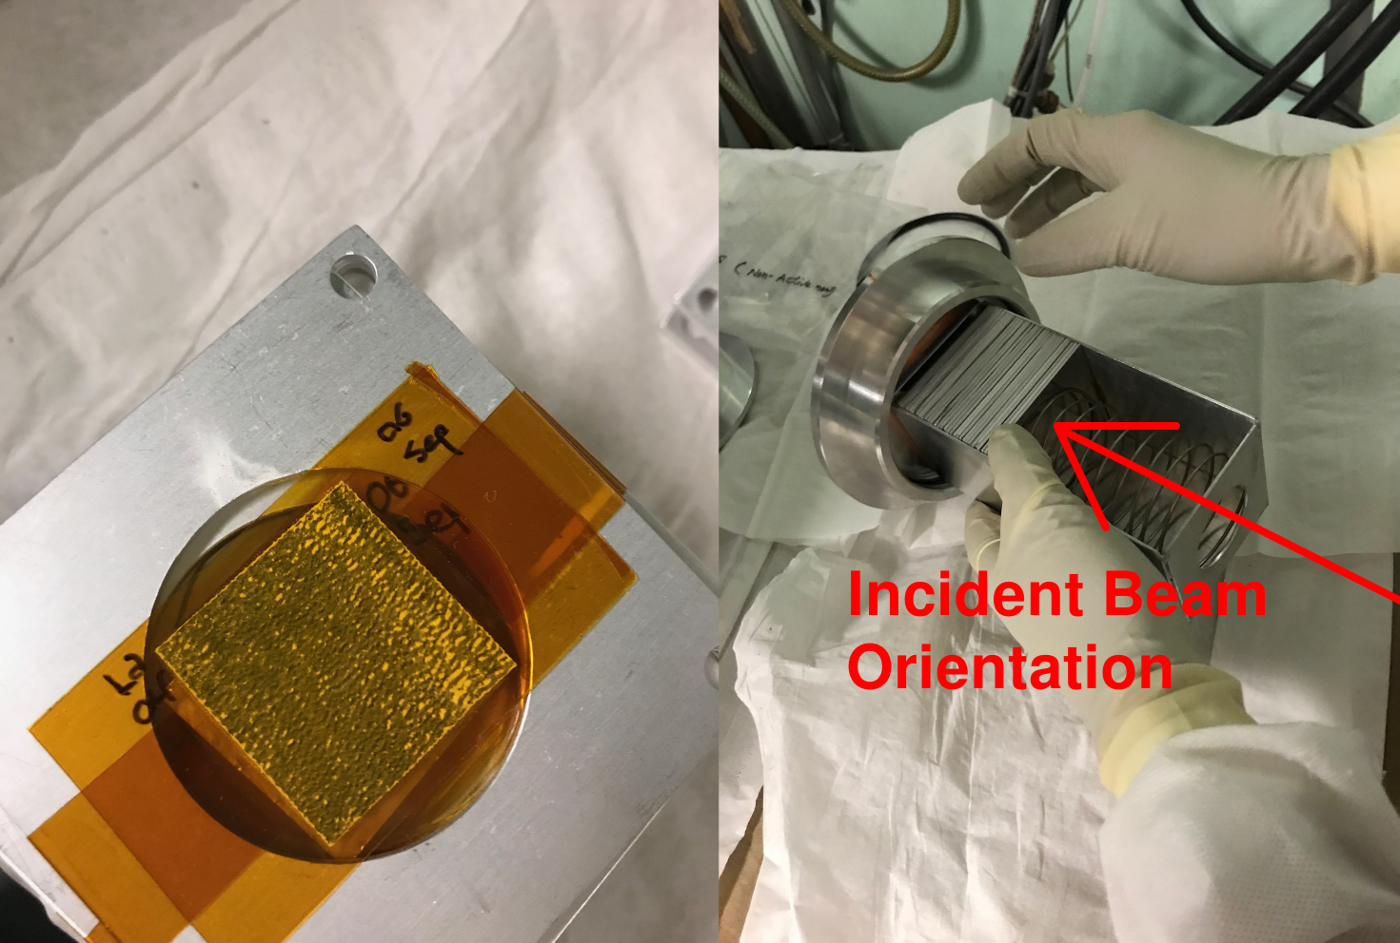
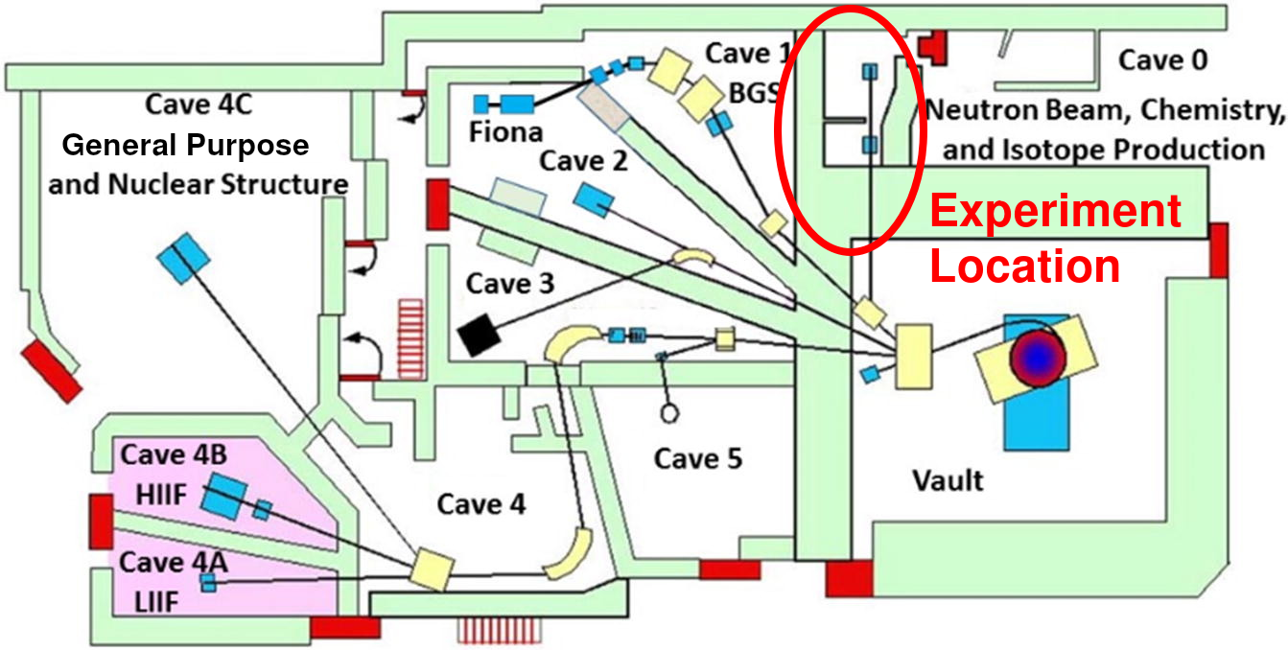
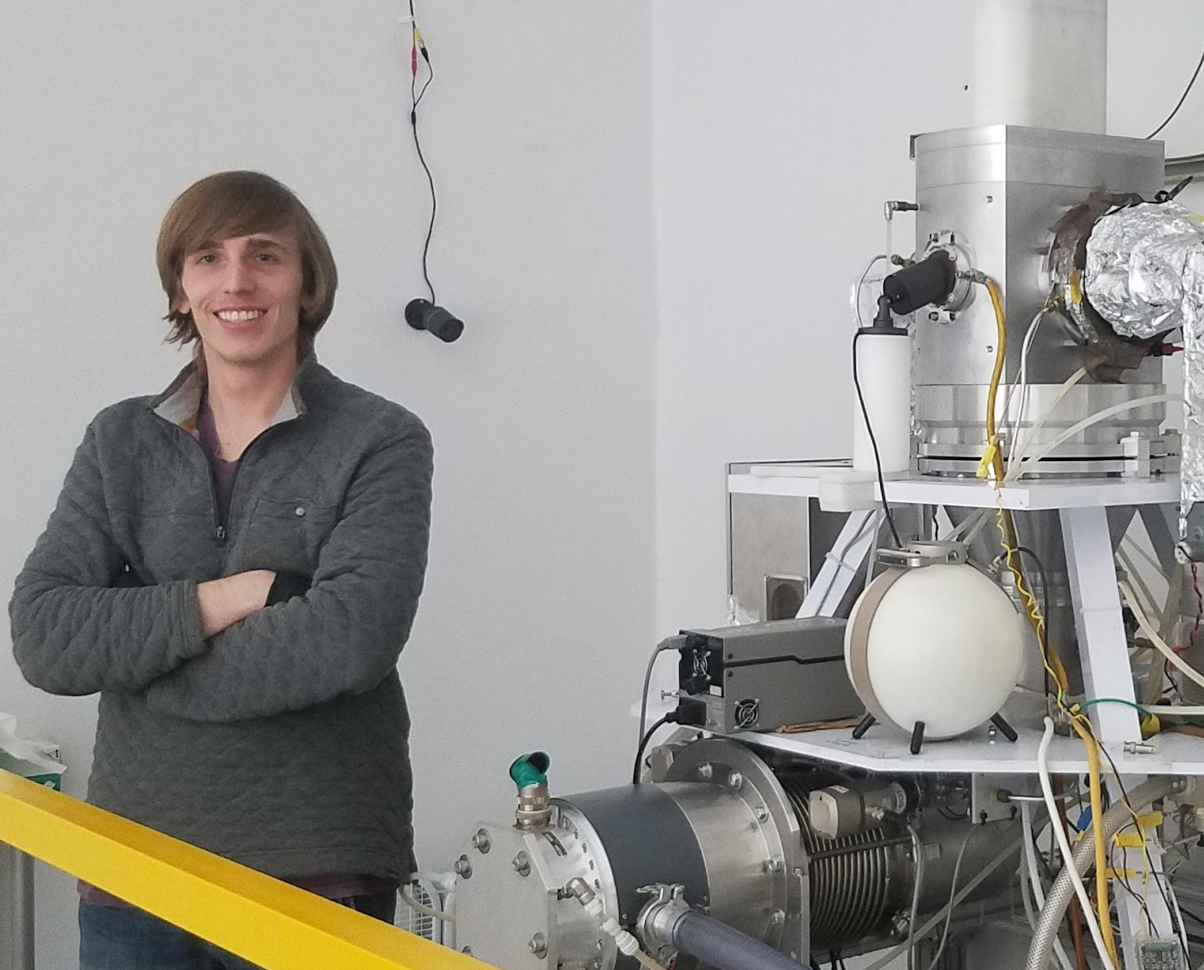

^{nat}La(p,x) XS Measurements
Motivation: production of ¹³⁴Ce through (p,6n) reaction
Cross sections un-measured and EMPIRE/TALYS predictions differ by >10x
Outcome: measured 10 excitation functions at 9 energy points using stacked target activation technique

Slide 2
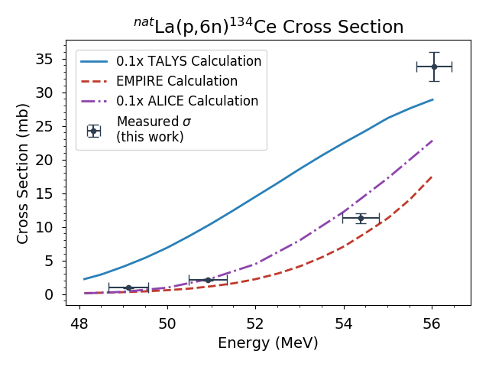
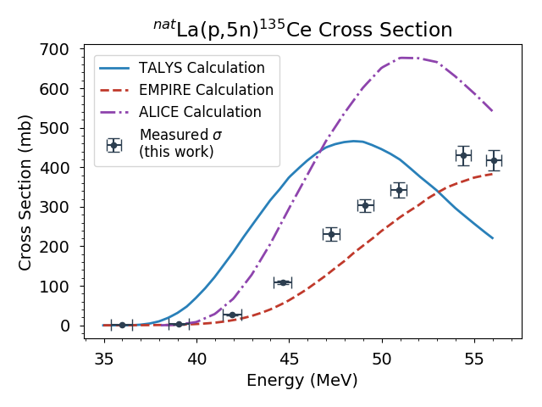
Measured La(p,x) Cross Sections
TALYS and ALICE overpredict (p,6n) cross section by >10x
Energy where XS peaks is also 8-10 MeV higher than predicted
Reaction code differences: Hybrid Monte-Carlo pre-equilibrium (EMPIRE) vs. Exciton model (TALYS, ALICE)
Implication: 70 MeV proton beam needed for ¹³⁴Ce production

Slide 3
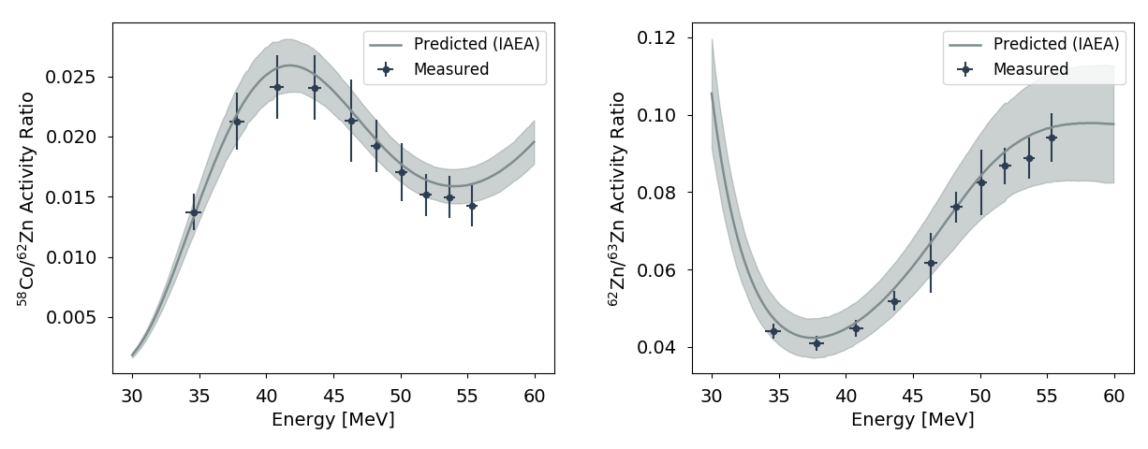
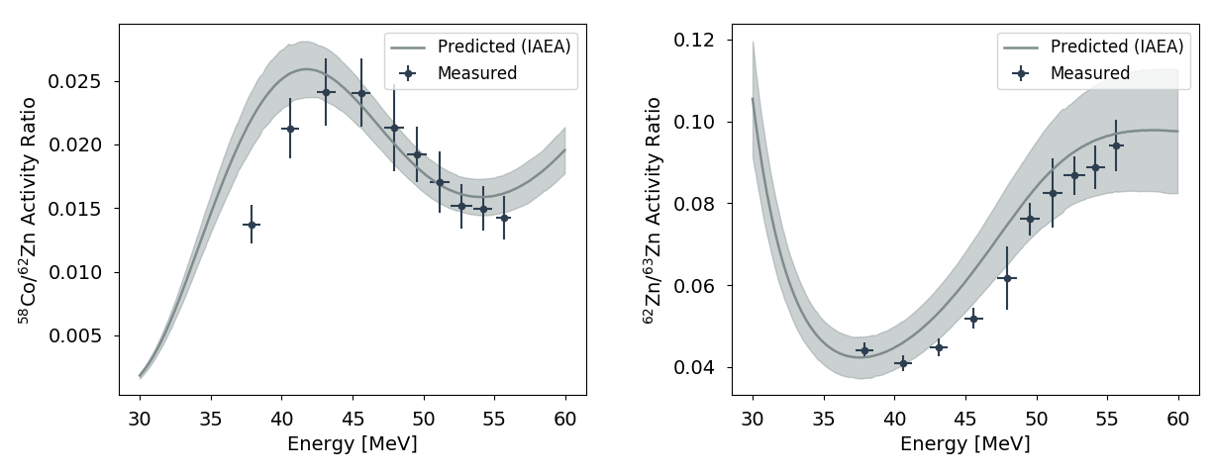
Other outcomes
Anderson/Ziegler Energies
^{nat}Cu(p,x)⁶¹Cu monitor reaction XS measured
Significant deviation (15%) between Anderson/Ziegler and MCNP6
Confirmed using isotope ratios for IAEA standards
Future work: explore in depth with other stacked target data
MCNP6 Energies

